Slide 1
Smart Aquarium
Using
Internet of Things(IOT)..
By,
ch.Karthik
M.Balraj
G.Sudeeptha
Aditi Kalkotwar

Slide 2
Abstract :
"To Help people keep connected to their Aquarium tank at all times to have a healthier tank by helping users to keep track of stats in the absence of user through the Internet/Smartphone."

Slide 3
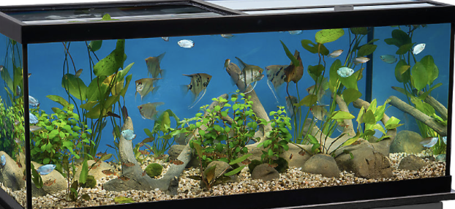
Introduction:
In the present existing aquariums, the owners/ users often need the human to check the aquarium and feed the fish.
Due to the increased work schedule, the owner/user might forget to check the aquarium at regular intervals.
This might lead to death of the fish.

Slide 4
Proposed Solution:
To solve the above problems, Smart Aquarium module could perform the following functions:
⦁ Measures the turbidity of the aquarium water and switch on the water filter when turbidity levels are beyond optimum range.
⦁ Checks the water temperature and switch on the water heater when the temperature is too low.
⦁ Senses the water levels and displays a message when the water levels are too low.
⦁ Automatically feeds the fishes at regular interval through an automatic feeding system.

Slide 5
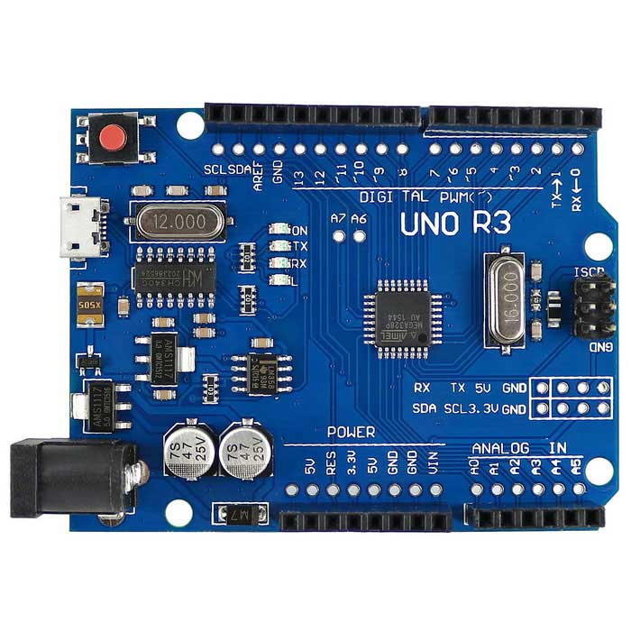
Software Requirement Specification:
Software Used:
Arduino IDE: Arduino integrated development environment is a cross-platform application that is written in used to writee and upload programs to the Arduino board.
It supports C and C++ using special rules of code structuring.The Arduino IDE converts the executable code into a text file in hexadecimal encoding that is loaded into the arduino board.

Slide 6
Language used:
EMBEDDED C:
Embedded C is a set of language extensions for the C programming language to address commonality issues that exist between C extensions for different embedded systems.
Embedded C uses most of the syntax and semantics of standard C.

Slide 7
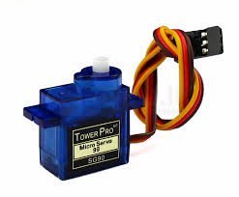
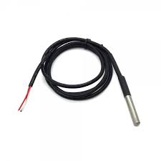
Hardware used:
Sensors used:
Servo motor: A servo motor is a rotary actuator that allows for precise control of angular or linear postion,velocity and acceleration.It consists of a suitable motor coupled to a sensor for postion feedback.It is often used in a closed loop control system.
DS 18B20 (Waterproof temperature sensor): The sealed digital temperature probe lets you precisely measure temperatures in wet environments with a simple 1-wire interface. It needs to be connected from a central microprocessor.It measures a temperature range of -550 C to 1250 C with an accuracy of + 0.50 C.

Slide 8
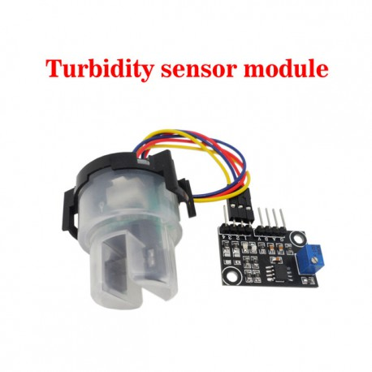
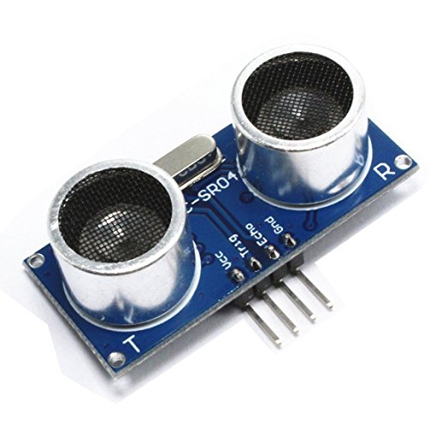
Turbidity sensor:
Turbidity is a quantitative measure of the suspended particles in a fluid. Turbidity sensor measures the amount of light that is scattered by the suspended particles in the water. As the amount of total suspended particles increase, the water's turbidity levels increase.
Ultrasonic sensor:
It measures distance by using ultrasonic waves. The sensor head emits an ultrasonic wave and receives the wave reflected from the target. It measures the distance to the target by measuring the time between emission and reception.

Slide 9
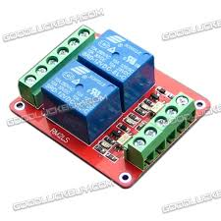
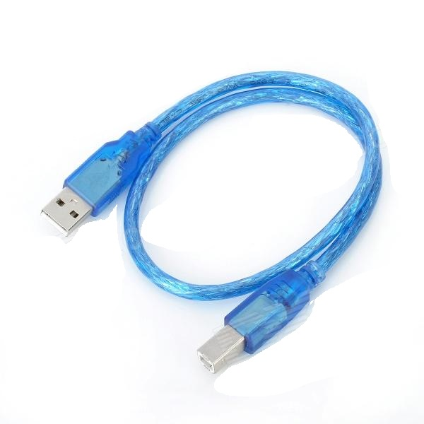
Relay Switch:
Relays are switches that open and close circuits electromechanically or electronically. Many relays use an electromagnet to mechanically operate a switch, but other operating principles are also used.
USB Cable:
To Dump the code from Computer to Arduino Uno, we use USB cable which transfer data in the form of 0's and 1's.

Slide 10
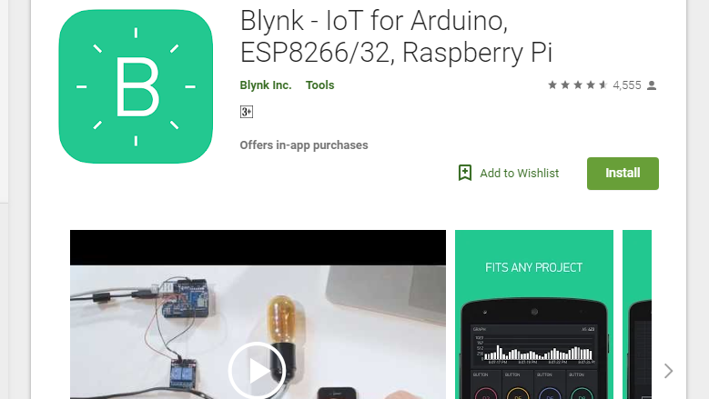
BLYNK App:
Blynk is not just "another IoT cloud".
It's an end-to-end solution which saves you time and resources
when building applications for connected products and services.

Slide 11
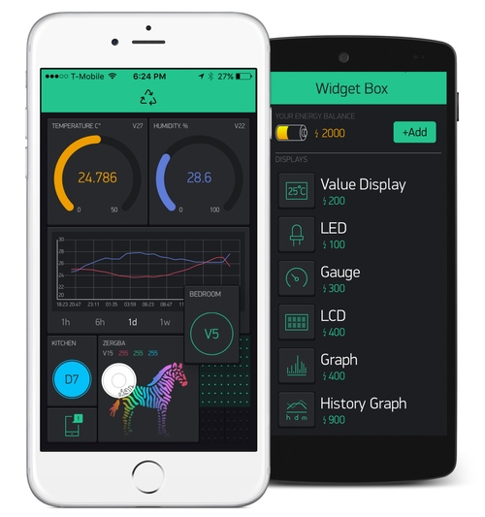
With Blynk,
A single engineer can get any electronic equipment online,
connect it to the Internet and build a mobile application in minutes to remotely monitor and control it.

Slide 12
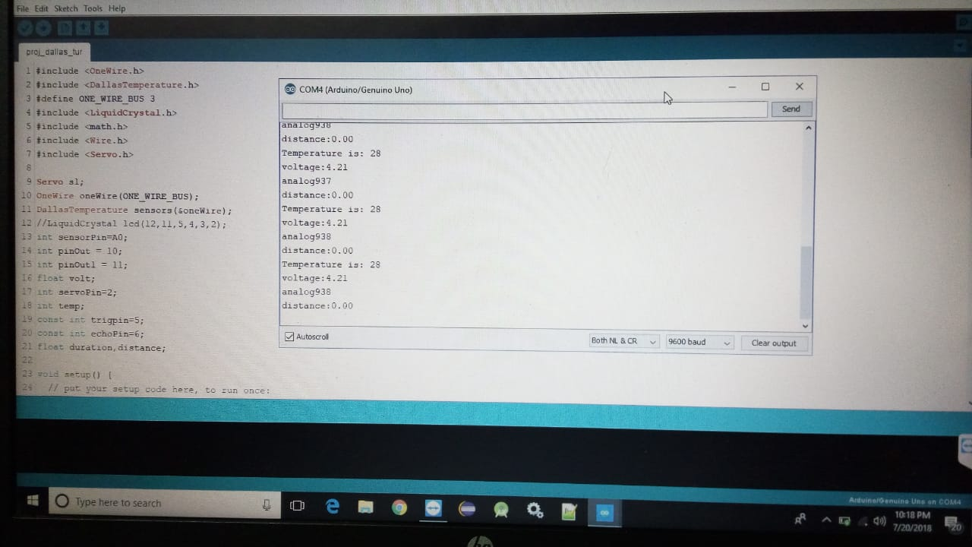
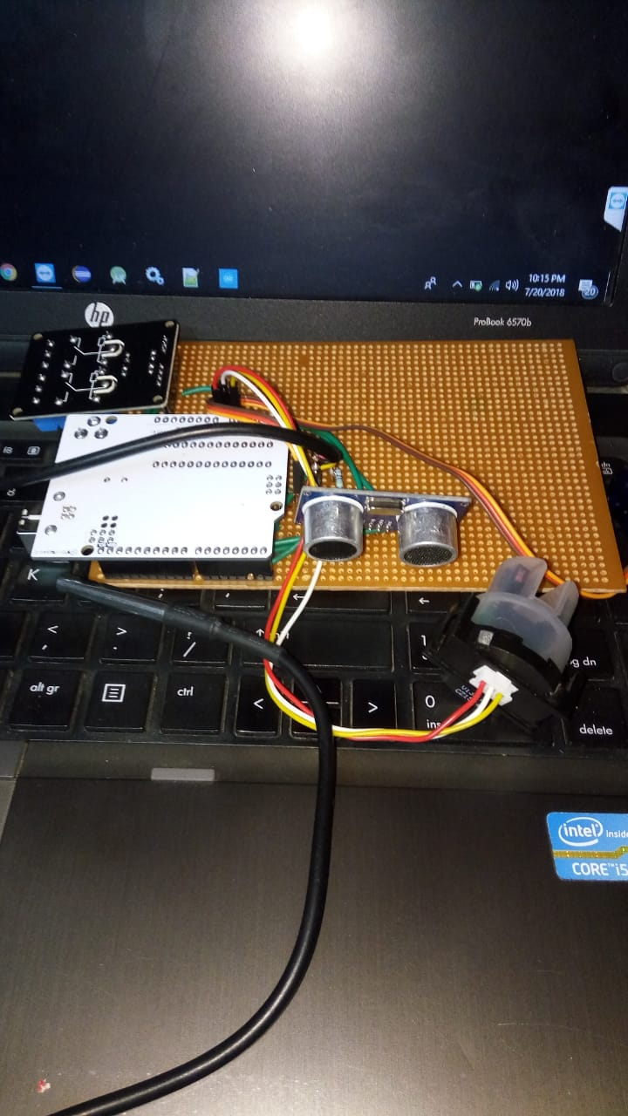

Slide 13
CONCLUSION:
Thus, by using the AquiClean module the problems
which are faced by aquarium users can be solved by automating the process of water cleaning and feeding
while maintaining optimum water levels and temperature.
This reduces the consumption of human time and efforts required for maintaining an aquarium and makes it easier to use in every home.

Slide 14
FUTURE SCOPE:
⦁ On a large scale, the AquiClean module can be used in artificial ponds for water maintenance and feeding of the fishes
⦁ It can be further used to keep track of the changes in water temperature and turbidity to predict the soil type in ponds.
⦁ The AquiClean module can also be used to check the water quality of large water bodies.
⦁ The AquiClean module can be used to predict when the water will get murky by keeping track of the time period between water changing.

